Slide 1
Arrival
Dismissal
Students will enter through the cafeteria.
There they will immediately have their temperatures taken.
You will also have to complete a safety attestation form.
Have Patience and follow all previously mentioned safety protocols.
Digital Late Passes
Students must leave the building immediately after their last class.
They will exit the building via the closest exit to their class.
There will be a single file, socially distanced line to wait for the bus to pick you up.
There are absolutely NO large gatherings allowed.

Slide 2
School Lunch
Students will all sit facing the entrance that they arrived through
6-foot distance is required
You may take off your mask to eat and then it must go right back on.
All Students must enter one way, and exit the other

Slide 3
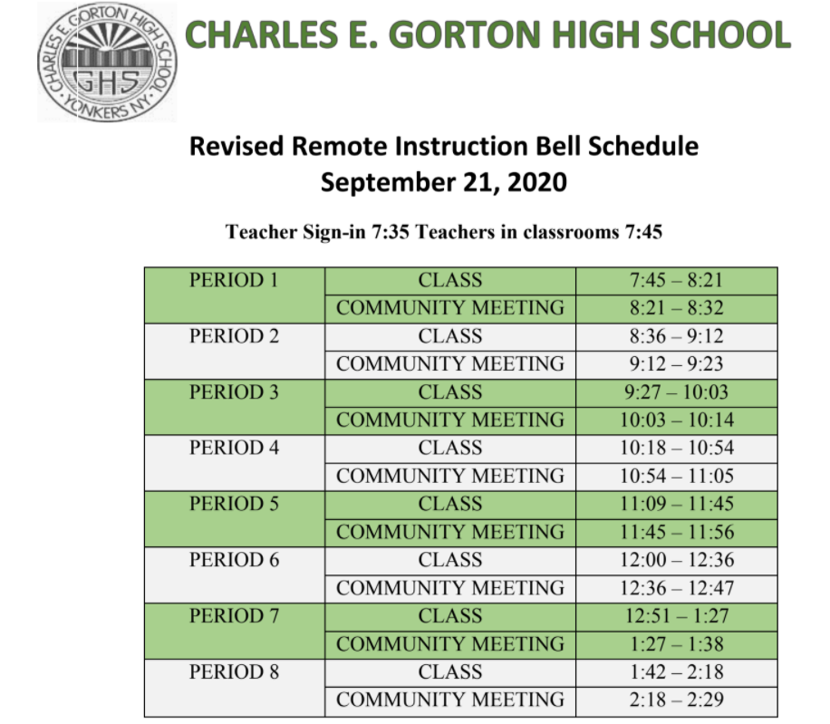
Hybrid Instruction
Students receive instruction in school at least 2x per week (excluding holidays).
Track A will attend school Monday and Tuesdays (excluding holidays)
Track B will attend school Thursdays and Fridays
Track C will attend school Mondays, Tuesdays, Thursdays and Fridays
Track D have opted for 100% remote instruction
Remote learning takes place on the day's students are not in school.
Students expected to go onto MS TEAMS during the class time (Remote Learning Schedule)
Attendance will be Counted on ALL SCHOOL DAYS
Students will be expected to be IN SCHOOL if Hybrid
Students will be expected to complete REMOTE assignments and LIVE lessons while at home.

Slide 4
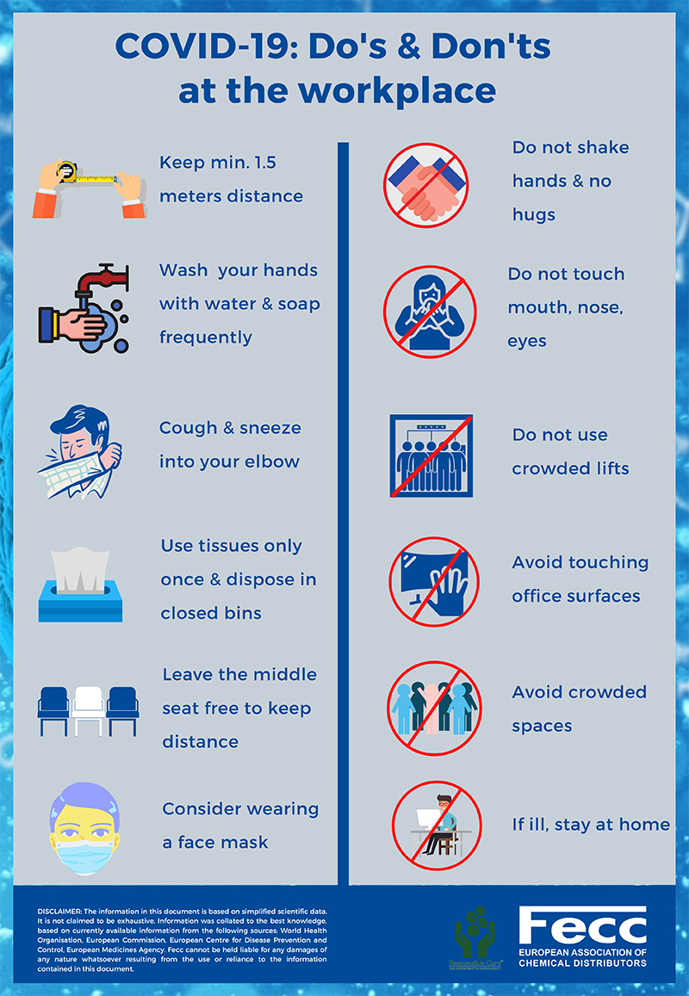
Hybrid Instructional Platform: Day to Day Safety
Wash your hands or sanitize frequently.
Wear your mask at all times. It should be covering both your mouth and nose.
Sneeze or cough with your face covering on and into your elbow.
Maintain your distance (at least 6 feet apart).
Follow the markings on the ground at school to help you with the flow of transitions.
ZERO TOLERANCE POLICY!!

